Slide 1
Day2 PPT
Osi models / tcp -ip architecture,Network,Communication

Slide 2
COMMUNICATIONS
It is how data in the form of energy travel across some medium from source to destination
Source
Transmitter
Transmission system
Receiver
Destination

Slide 3
PROTOCOLS
During communication all parties involved in a communication must agree in a set of rules to be used when exchanges message . Thus set of rules which is comply by both sender and receiver is called protocol.
A communication application does not communicate with communication hardware directly

Slide 4
KEY ELEMENT OF PROTOCOL
Syntax-
-data formats
-Signal levels
SEMANTICS
-control information
-error handling

Slide 5
OSI MODEL
OSI refers to open system interconnection
Developed by ISO
It has seven layers

Slide 6
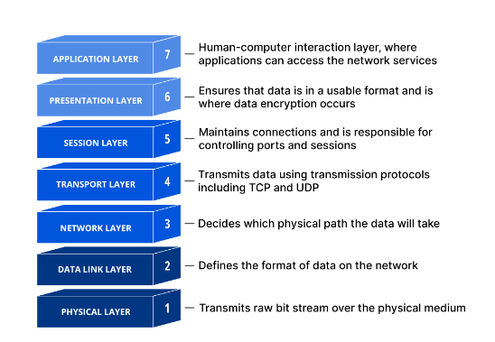
OSI LAYERS

Slide 7
PHYSICAL LAYER
Physical layer interface between data transmission device and transmission medium or network
This layer includes the physical equipment involved in the data transfer, such as the cables and switches.
This is also the layer where the data gets converted into a bit stream, which is a string of 1s and 0s.
The physical layer of both devices must also agree on a signal convention so that the 1s can be distinguished from the 0s on both devices.

Slide 8
DATA LINK LAYER
It provides error free bit streams across physical media.
Error-detection
Reliability
Flow control
Specifies how to organize data into frames and how to transmit frames over a network

Slide 9
NETWORK LAYER
Controls the operations of the network
Routing – determine the path from source of message to destination
Congestion control-handling traffic jams

Slide 10
TRANSPORT LAYER
Responsible for end-to-end communication between the two devices.
This includes taking data from the session layer and breaking it up into chunks called segments before sending it to layer 3 .
The transport layer on the receiving device is responsible for reassembling the segments into data the session layer can consume.

Slide 11
SESSION LAYER
This is the layer responsible for opening and closing communication between the two devices.
The time between when the communication is opened and closed is known as the session.
The session layer ensures that the session stays open long enough to transfer all the data being exchanged, and then promptly closes the session in order to avoid wasting resources.

Slide 12
PRESENTATION LAYER
This layer is primarily responsible for preparing data so that it can be used by the application layer; in other words, layer 6 makes the data presentable for applications to consume
. The presentation layer is responsible for translation, encryption, and compression of data.

Slide 13
APPLICATION LAYER
This is the only layer that directly interacts with data from the user.
Software applications like web browsers and email clients rely on the application layer to initiate communications. But it should be made clear that client software applications are not part of the application layer; rather the application layer is responsible for the protocols and data manipulation that the software relies on to present meaningful data to the user.

Slide 14
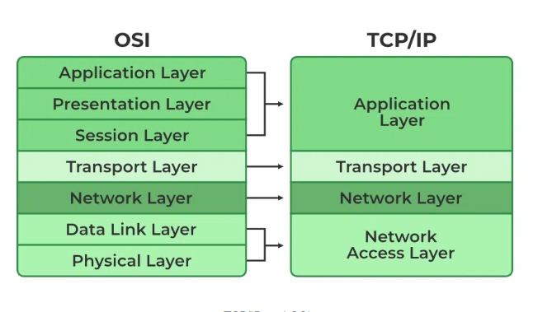
TCP/IP PROTOCOL ARCHITECTURE
Developed by US defense advanced research project agency for its packet switched network
Use by the global internet
No official model but a working one
-Application layer
Transport layer-host to host
Internet layer-network routing
Network access layer
Physical layer

Slide 15
NETWORKING
A computer network comprises two or more computers that are connected—either by cables (wired) or wifi (wireless)—with the purpose of transmitting, exchanging, or sharing data and resources.
There are many types of network-transportation , postal service , telephone network

Slide 16
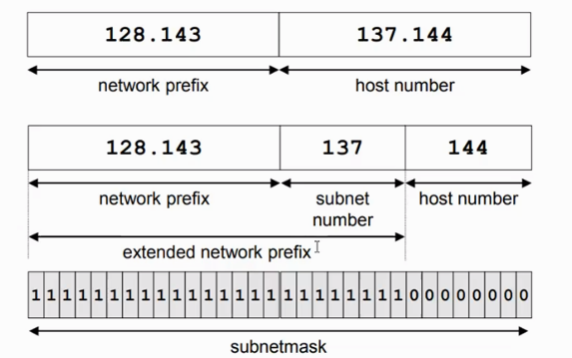
SUBNET MASK
Routers and hosts use an extended network prefix(subnet mask ) to identify the start of host numbers

